Slide 1
RESUME SHOWCASE SYSTEM IN AWS
Group Members
Aashutosh Singh Gautam (R19CS008)
Akshay Anand (R19CS023)
Jayesh Tandon (R19CS137)
Group No: AWS 40
Project Guide: Dr. Vishwanath Y

Slide 2

Contents
Abstract
Introduction
Methodology
Result and outcome
Implementation
Applications
References

Slide 3
Abstract
Amazon Web Services offers a broad set of global cloud-based products including compute, storage, databases, analytics, networking, mobile, developer tools, management tools, IoT, security, and enterprise applications: on-demand, available in seconds, with pay-as-you-go pricing.
From data warehousing to deployment tools, and directories to content delivery, over 200 AWS services are available. New services can be provisioned quickly, without the upfront fixed expense. This allows enterprises, start-ups, small and medium-sized businesses, and customers in the public sector to access the building blocks they need to respond quickly to changing business requirements.
Resume Showcase System is a web-based dashboard platform where students can visit and upload their resumes and the Company Managers visit to find new talents HR / Recruiter can see the resume of all the professionals who have uploaded this ensures easy and direct communication.

Slide 4
Introduction
Resume Showcase System is a web-based dashboard platform where students can visit and upload their resumes and the Company Managers visit to find new talents HR / Recruiter can see the resume of all the professionals who have uploaded this ensures easy and direct communication.

Slide 5

METHODOLOGY

Slide 6
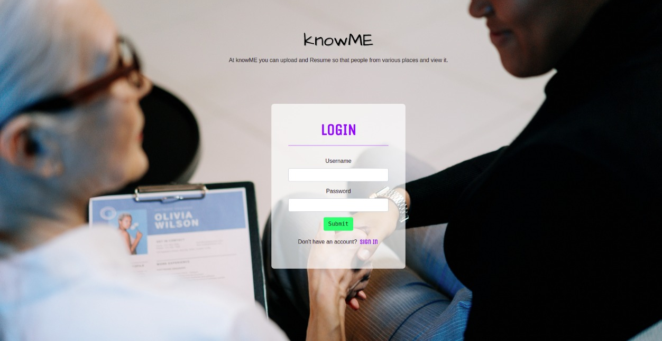
LOGIN page

Slide 7
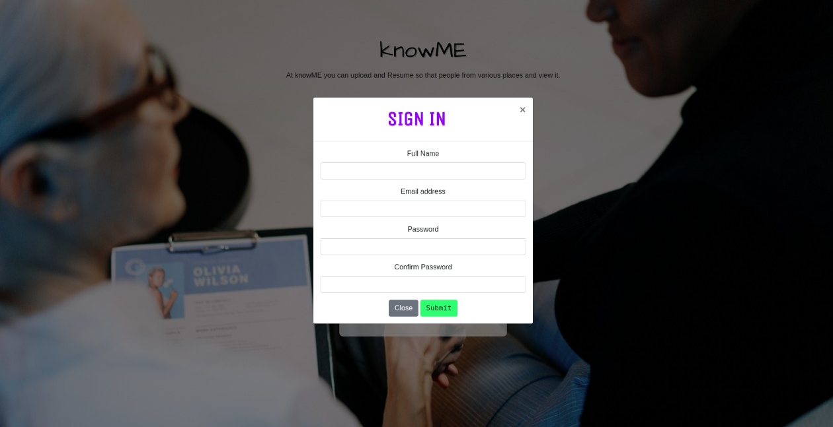
SIGNIN page

Slide 8
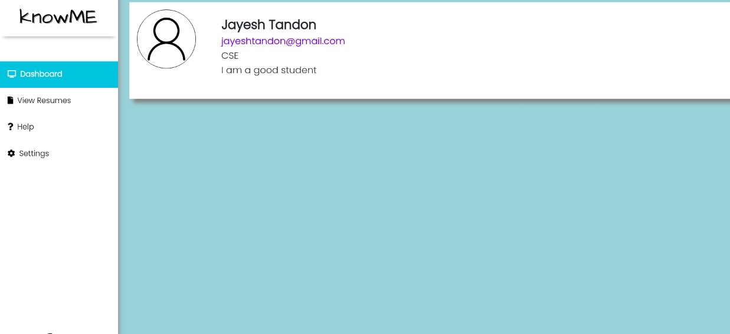
RESULT AND OUTCOME (DASHBOARD)

Slide 9
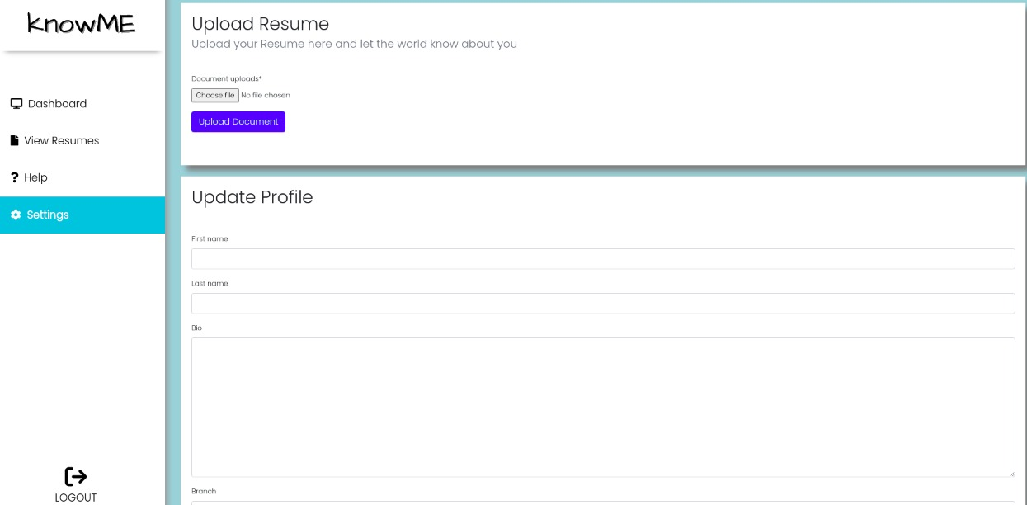
UPLOAD RESUME

Slide 10
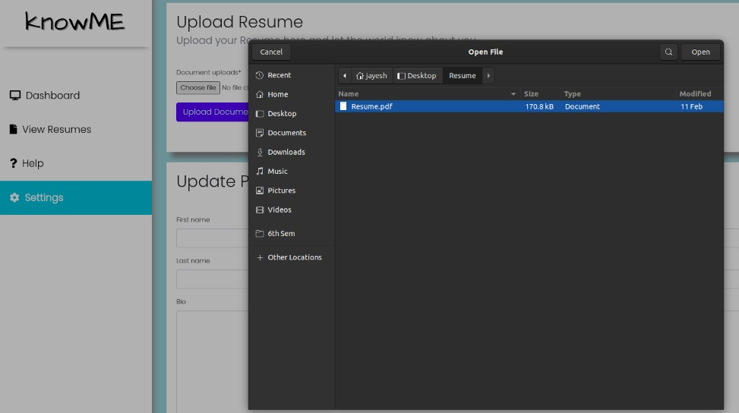
You can upload your Resume

Slide 11
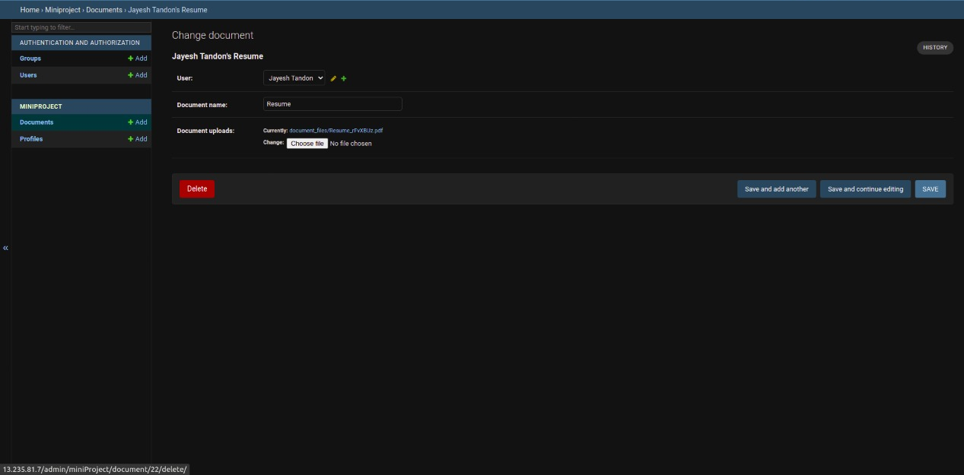
Admin page

Slide 12

Explore more

Slide 13
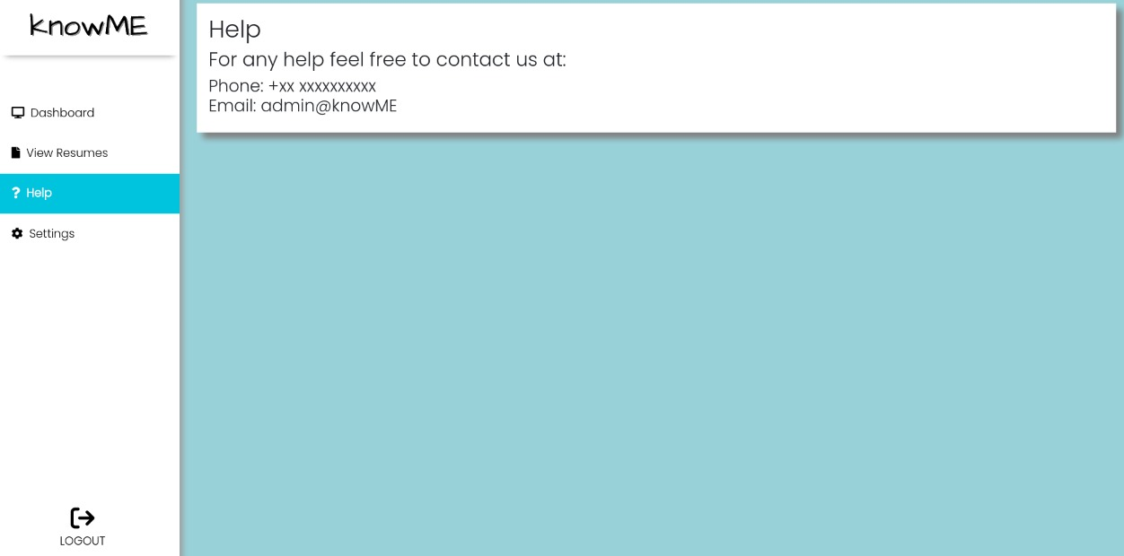
MORE FEATURES

Slide 14

Problem Definition
We are solving problems faced by students at the time of Resume building and profile building.
There are many sites for resume upload and creating new resumes based on the provided template but students often get confused there which one to choose accordingly to their qualifications.
On our knowMe site they can check their batchmate’s resume and other people resume and get a proper idea of what should be done and can upload their resume for others to see for reference and hiring.

Slide 15

Literature Survey
The first impression of a job applicant has traditionally been made through the resume and, despite many technological advancements since the initial resume-related publications began to appear in the research literature, the resume remains a common application component.
Thus, the purpose of our knowME site is to make people aware of resume building and showcasing their resumes on a site from where business organizations can observe them.

Slide 16

Libraries and packages used
Bootstrap
Django
AWS EC2
HTML ,CSS , JAVA SCRIPT

Slide 17
Implementation details
FRONTEND : The frontend of a website is everything with which the user interacts. From a user standpoint, the frontend is synonymous with the user interface. From a developer standpoint, it is the interface design and the programming that makes the interface function.
HTML : The Hyper Text Markup Language or HTML is the standard markup language for documents designed to be displayed in a web browser. It can be assisted by technologies such as Cascading Style Sheets and scripting languages such as JavaScript.
CSS : CSS stands for Cascading Style Sheet, it is a style sheet language used to shape the HTML elements that will be displayed in the browsers as a web-page.

Slide 18
Backend: Django is known as the web framework for perfectionist with deadlines. It is a Python based framework that follows the model-template-views architecture.
Benefits of using Django as the Backend framework:
It is highly secure
Powered by Python – easy to use for developers
Provides a default Admin Panel
Good for search engine optimization
Has a great set of libraries

Slide 19
DJANGO PROJECT Deployed using AWS :
Step 1: Create a Django Project. Build a Django App inside it and write the code for frontend (HTML templates, with Bootstrap CSS) and the backend in Python using the various libraries provided.
Step 2: Initialize an EC2 in the AWS Dashboard. Make sure the security group contains Inbound Rules for port 80 so that the website can be accessed over the HTTP protocol from across the web.
Step 3: Inside the windows EC2 instance,
Install Python
Install the various libraries and packages required for the project using pip
Copy the Project files

Slide 20
DJANGO PROJECT Deployed using AWS :
Step 4: Run the project inside the EC2 instance with host as 0.0.0.0:80
Step 5: From the EC2 dashboard, copy the Public URL provided by AWS and open it with http protocol because our website is running on port 80
Step 6: We can see our website up and running on the internet which can now be accessed by anyone.

Slide 21
Applications
Resume Showcase System knowME site is to make people aware of resume building and showcasing their resumes on a site from where business organizations can observe them.
This can also be used in cases when many a times the candidate forgets to take their resume for interview. They can open it from this website anytime and present it to the HR.

Slide 22
References
Django Documentation :
https://docs.djangoproject.com/en/4.0/
Bootstrap Documentation
https://getbootstrap.com/docs/4.6/getting-started/introduction/
Deployment of Django on AWS
https://www.youtube.com/watch?v=lH9bwNvaHww
Literature Survey
Risavy, Stephen. (2017). The Resume Research Literature: Where Have We Been and Where Should We Go Next?. Journal of Educational and Developmental Psychology. 7. 169. 10.5539/jedp.v7n1p169.

Slide 23
Thank You…..

